Slide 1



Adidas Sales Analysis
View in Power BI
Last data refresh:
23/04/2025 13:17:41 UTC
Downloaded at:
23/04/2025 13:19:23 UTC

Slide 2
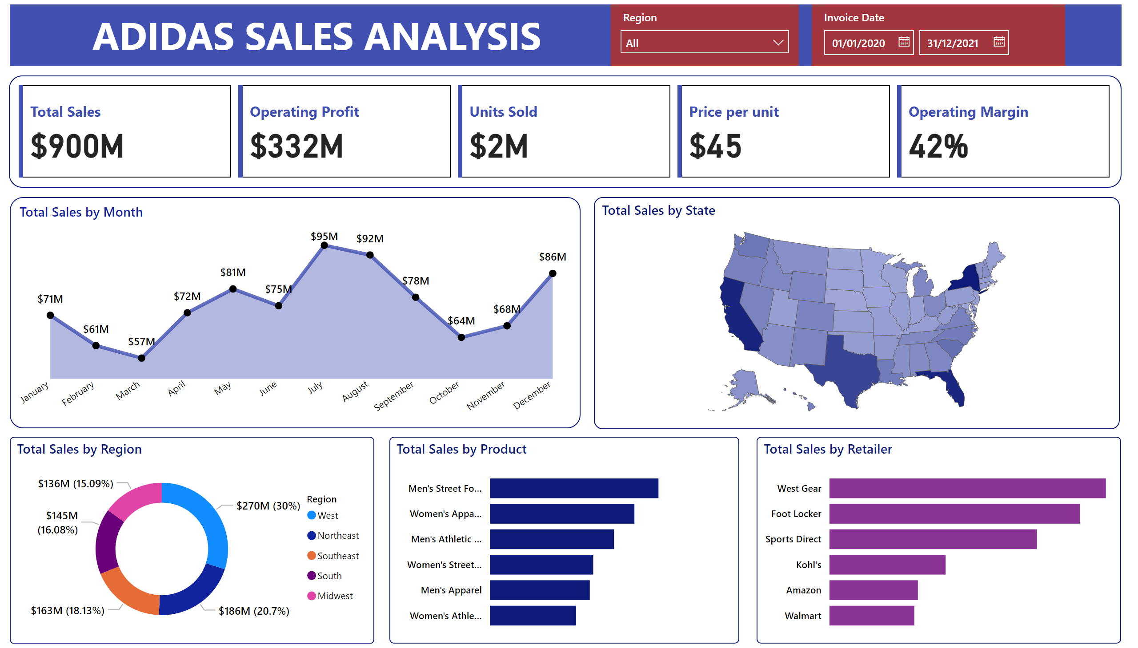
Page 1
Notes:
textbox
No alt text provided
shape
No alt text provided
textbox
No alt text provided
cardVisual
No alt text provided
Total Sales by Month
No alt text provided
Total Sales by State
No alt text provided
Total Sales by Region
No alt text provided
Total Sales by Product
No alt text provided
Total Sales by Retailer
No alt text provided
slicer
No alt text provided
slicer
No alt text provided

